Slide 1
Disney | Stock Factor Analysis.
June 30, 2020

Slide 2
Agenda.
Question.
Analyses.
Summary.
What’s next?

Slide 3
The Walt Disney Corporation represented 38% of the US film market in the year 2019, making it the dominant force in American film production. However, theatrically released films make up only a fraction of Disney’s revenue. Our team will look at Disney’s financial statistics and find out which factors most impact the Walt Disney corporation’s market value. We will examine internal factors, like film and online release statistics, as well as more external ones, like unemployment and greater market trends. This will allow our team to examine what has the greatest impact on the most dominant company in entertainment.

Slide 4
Question.
What are some of the factors that affect the price of Walt Disney Company stock?

Slide 5

Why?
Walt Disney Company
The Walt Disney company is a diverse company that’s more than just an animated film producer.
We wanted to look at if a successful box office could affect the stock price along with other internal and external factors.

Slide 6
Analyses.

Slide 7
Gross Profits and Revenue
We wanted to have a baseline for further analysis, so first we examined the most logical elements to impact the Walt Disney price. To do so we analyzed the Disney’s quarterly reports.

Slide 8
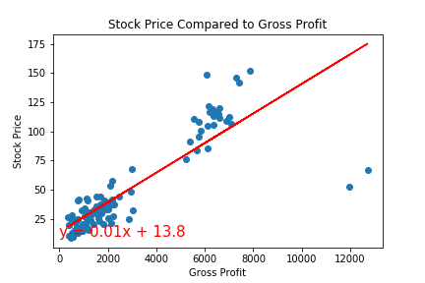
Gross Profits vs. Stock Price
Comparing the gross profits to the share price quarterly, we can see a strong positive correlation just in the graph itself.
The correlation between these two variables in the data set: .85.

Slide 9
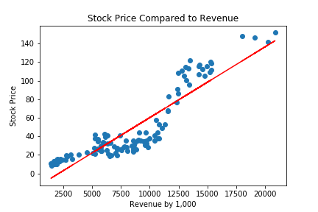
Revenue vs Stock Price
Reported revenue is even more correlated to the quarterly stock price.

Slide 10
Analyses.
Box office revenue.
Text…

Slide 11
Analyses.
Unemployment rate and initial claims.
Does the unemployment rate and initial unemployment claims have a correlation with Disney stock price?

Slide 12
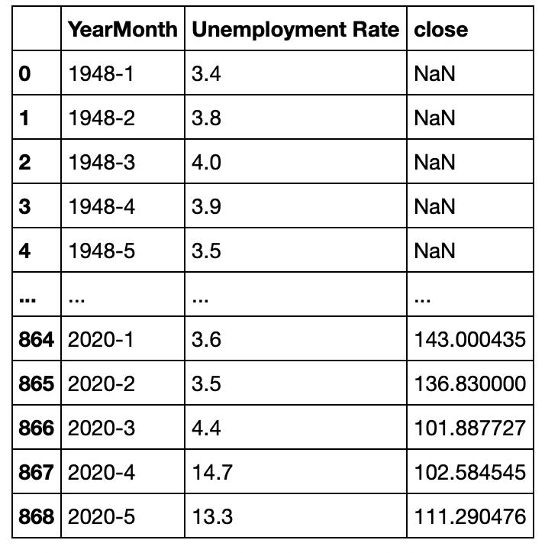
Data.
Data cleaning example.
Data cleaning for all three datasets involved formatting and grouping by Year-Month and removing rows with any null values.

Slide 13
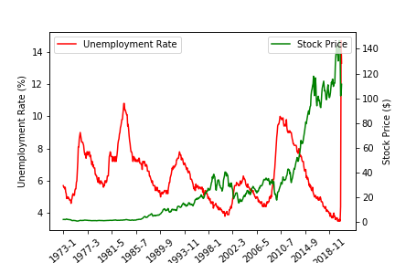
Data.
Plot.
It is evident that particularly after year 1989, unemployment rate and stock price are inversely correlated. The correlation coefficient is -0.36.

Slide 14
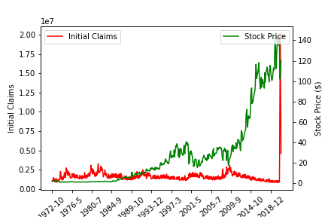
Data.
Plot again.
There is not much correlation between initial unemployment claims and stock price. The correlation coefficient is -0.02. However, we do see an interesting spike in claims after March 2020.

Slide 15
Analyses.
Newsworthiness.
Based on New York Times articles, does the number of articles per week represent the magnitude of change in the stock price?

Slide 16
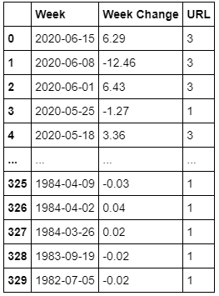
Data.
Combined data.
With historical stock price data, we were able to create a table that calculated the change in price during a specific week, along with the number of NYT articles based on publish date.

Slide 17
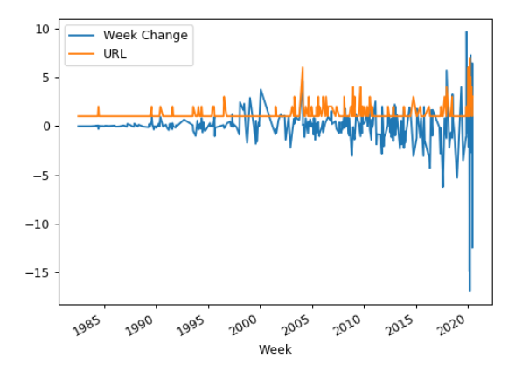
Data.
Plot.
With a quick eye test, we see occurrences of the two lines spiking together. Since we are just looking for change (positive or negative), anytime the article count spikes, we should see fluctuation with the stock price.

Slide 18
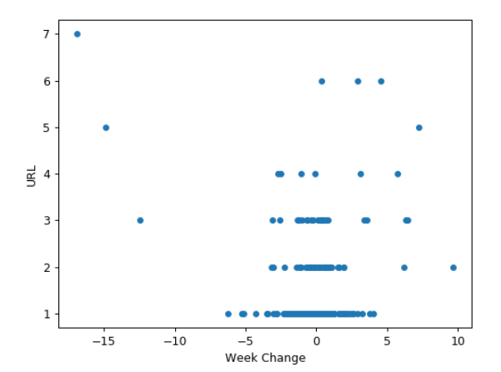
Data.
Plot again.
Using a scatter plot, we see that as we move higher up in article count, the more we see points move towards the sides, representing a large stock price change.

Slide 19
Summary.

Slide 20
Summary.
From the 5 factors we looked at, we determined # of them have a relationship with the stock price.

Slide 21
What’s next?

Slide 22
What’s next?
Look into more factors.
Connect the different factors.
Send to Walt Disney Company.
Become millionaires.

